Slide 1
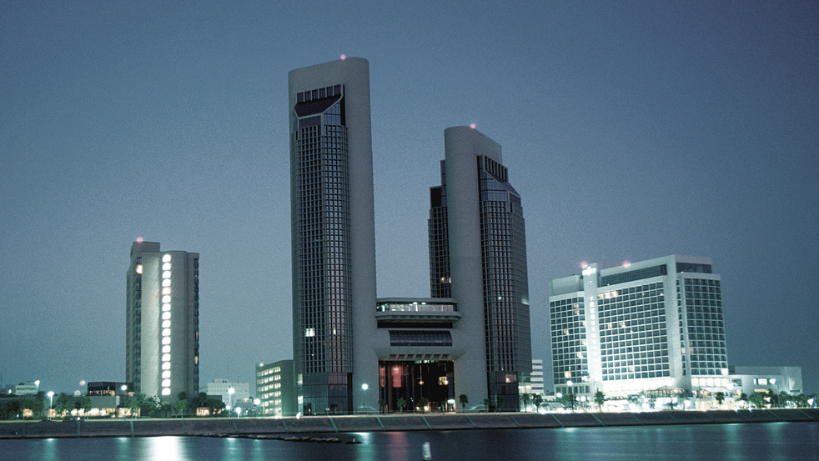
City of Corpus Christi, Texas
UDC Evaluation
March 20-21, 2019
Notes:
Gary

Slide 2
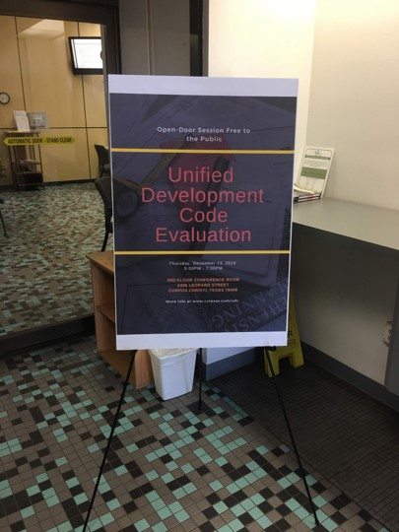
Overview
Background & Public Engagement
Evaluation
Next Steps
Comments / Q&A / Posters
Notes:
Gary

Slide 3
Background
| Timeline
2018 2019
OCT NOV DEC JAN FEB MAR APR MAY
TRIP #1 #2 #3 #4
TASK 1: KICK-OFF AND INTRODUCTION
Kick-Off Teleconference
Review of Plan Documents and Ordinances
Introductory Presentation
TASK 2: RECONNAISSANCE AND INTELLEGENCE
Field Reconnaissance and Planning Staff and TRC Meeting
Planning Commission Meeting
Stakeholder Roundtables and FIRST Open Door Meeting
Staff Teleconference
TASK 3: EVALUATION AND REPORT DRAFTING
Draft Evaluation
Planning Staff, TRC, and SECOND Open Door Meeting
Final Evaluation
TRC and Planning Commission Meeting
City Council Meeting
TASK 4: PHASE 2 SCOPING
Work Program, Project Schedule, and Budget Estimate for UDC Amendments
P
*
*
*
Task Duration
WebEx Teleconference
Staff Meeting
Stakeholder Roundtables
*
Planning Commission / City Council
Deliverable
Notes:
Brian

Slide 4
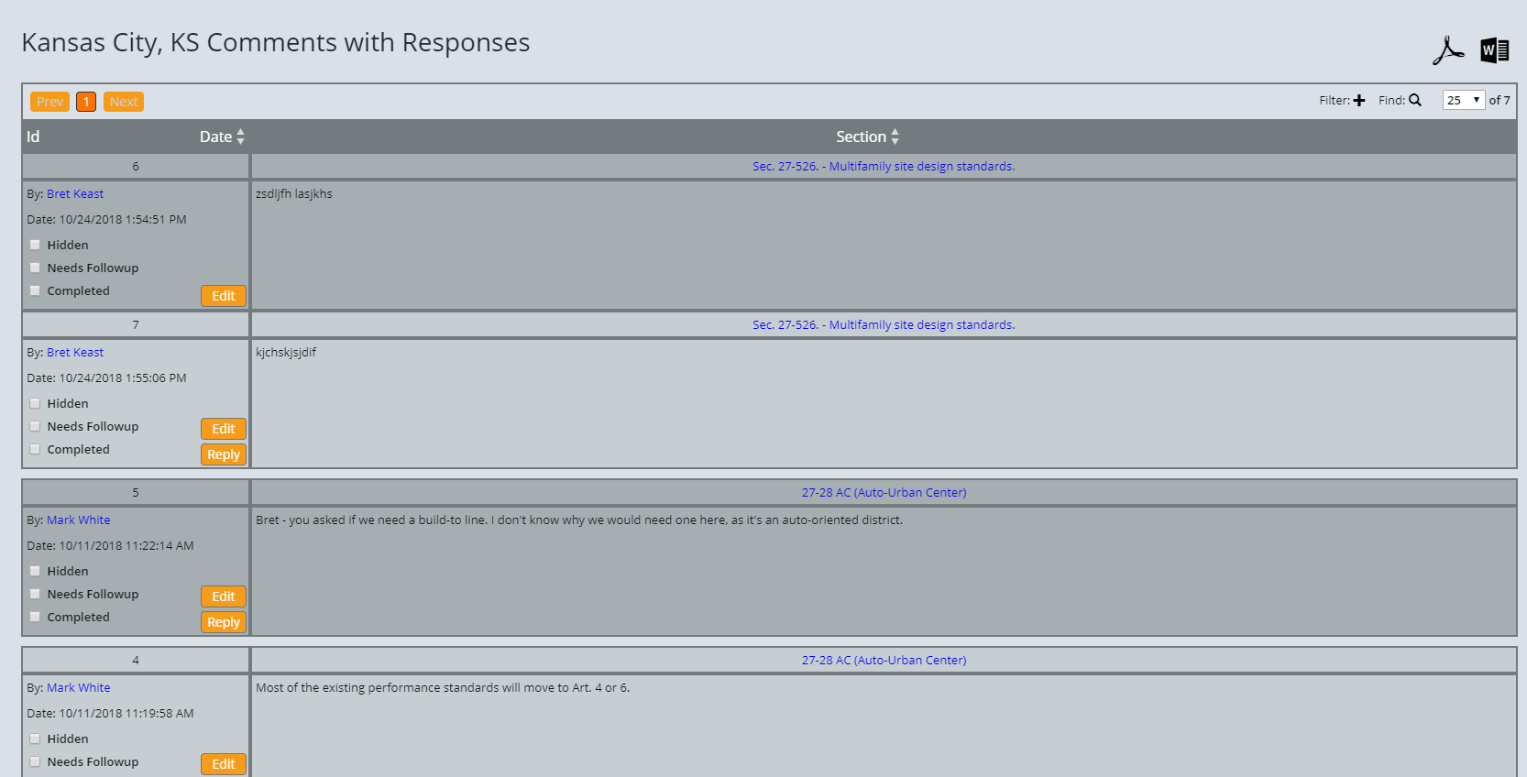
Background
| Known Issues
Digital ease of use - enCodePlusTM
Reorganization / consolidation of tables
Efficiency of overlay/special purpose districts
Clarification of Trust Fund
Best practices for incentivizing:
Appropriate increased density
Affordable / work force housing
Low-impact development
Online Drafting in Word-like format
Collaborative drafting and editing
Hyperlinks of definitions and cross-references
Password-protected commenting
Documentation via track-changes
Personalized tracking
Comment management system
Searchable comment/response record
Denote required follow-ups
Notes:
Brian

Slide 5
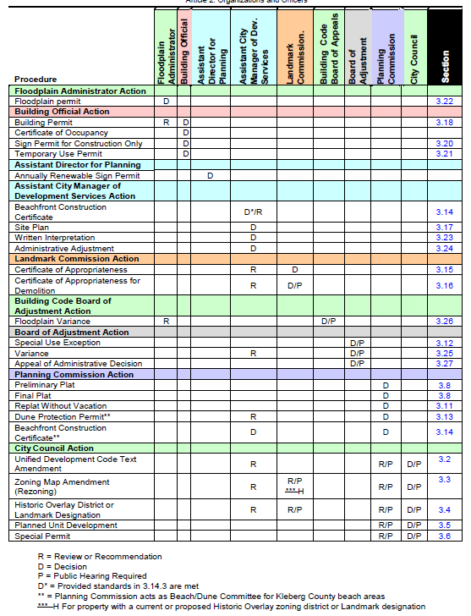
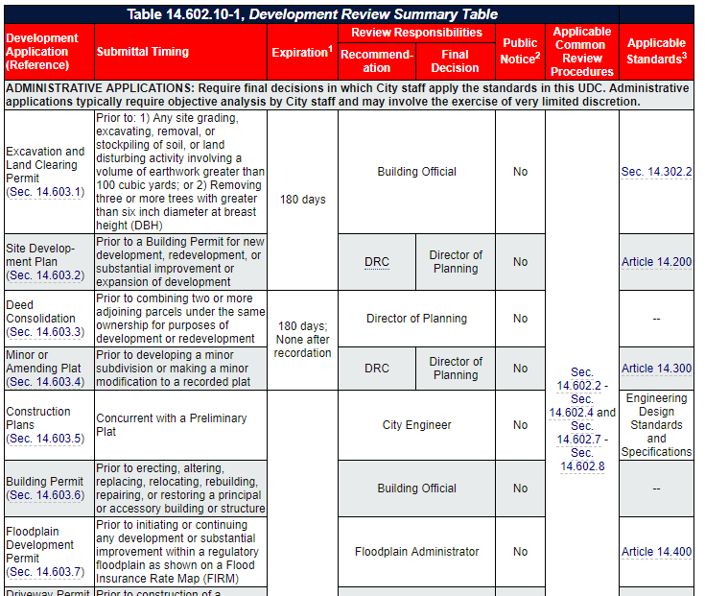
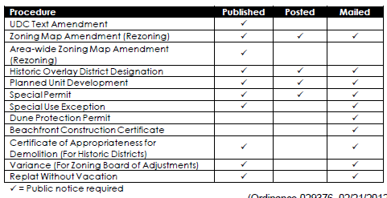
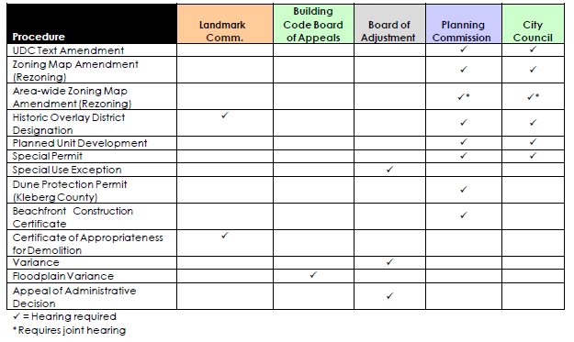
Background
| Known Issues
Digital ease of use - enCodePlusTM
Reorganization / consolidation of tables
Efficiency of overlay/special purpose districts
Clarification of Trust Fund
Best practices for incentivizing:
Appropriate increased density
Affordable / work force housing
Low-impact development
Notes:
Brian

Slide 6
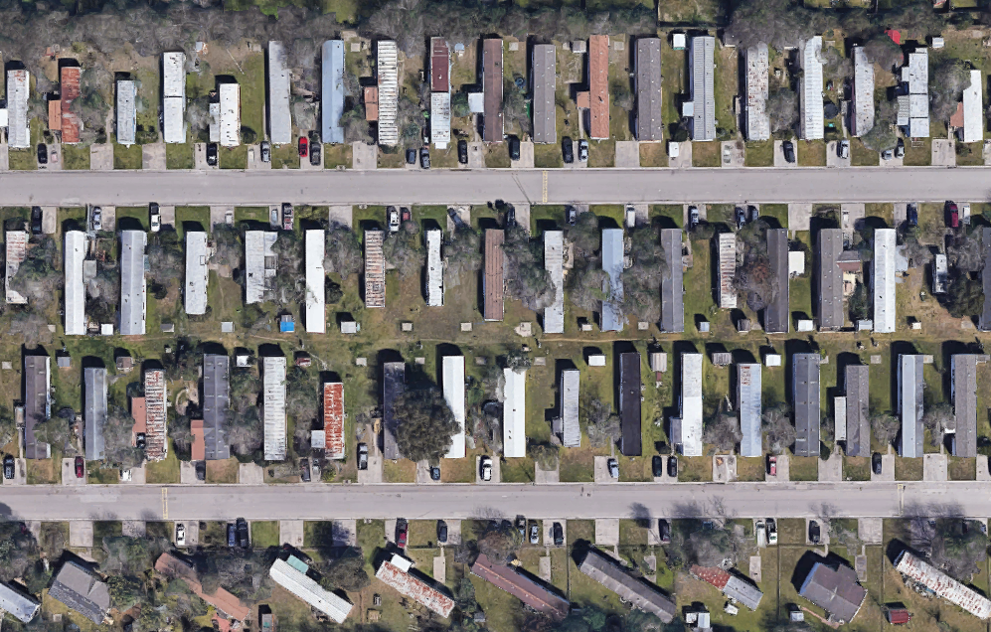
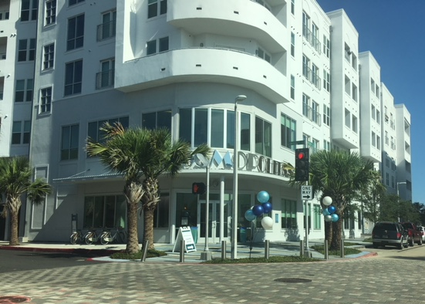
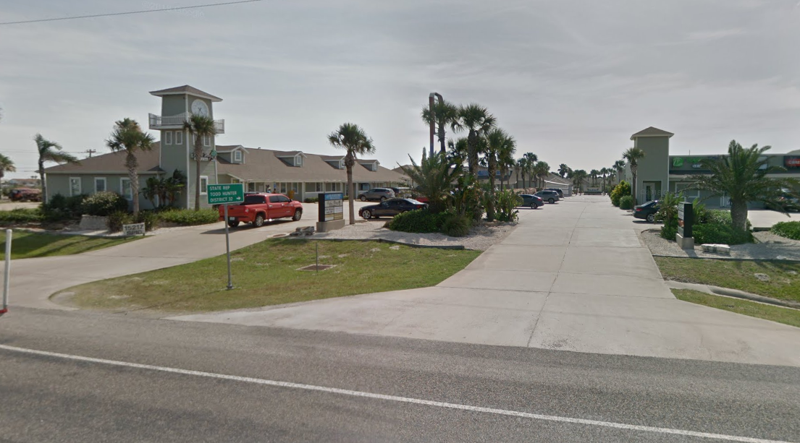
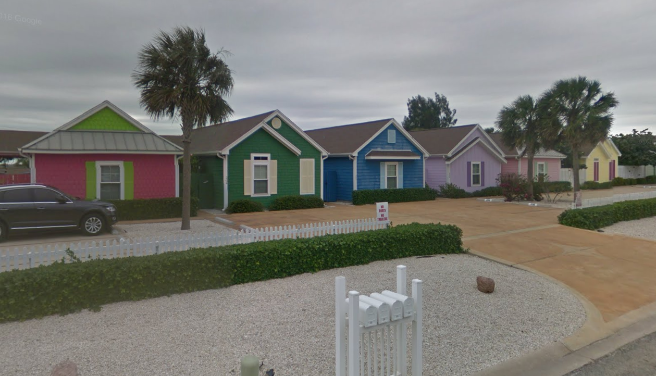
Background
| Known Issues
Digital ease of use - enCodePlusTM
Reorganization / consolidation of tables
Efficiency of overlay/special purpose districts
Clarification of Trust Fund
Best practices for incentivizing:
Appropriate increased density
Affordable / work force housing
Low-impact development
Notes:
Brian

Slide 7
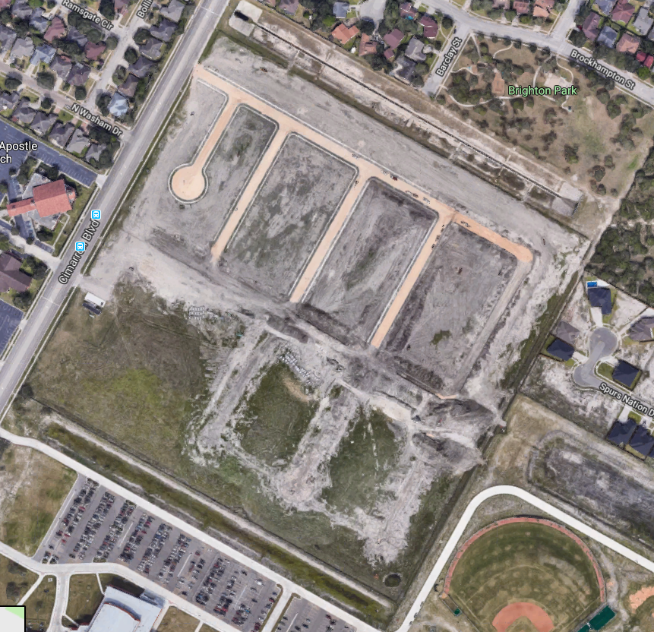
Background
| Known Issues
Digital ease of use - enCodePlusTM
Reorganization / consolidation of tables
Efficiency of overlay/special purpose districts
Clarification of Trust Fund
Best practices for incentivizing:
Appropriate increased density
Affordable / work force housing
Low-impact development
Notes:
Brian

Slide 8
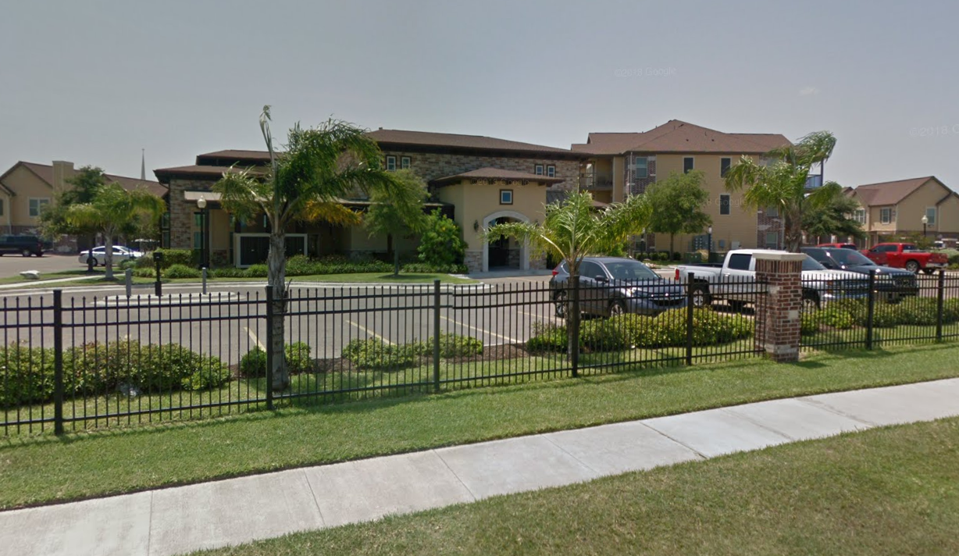
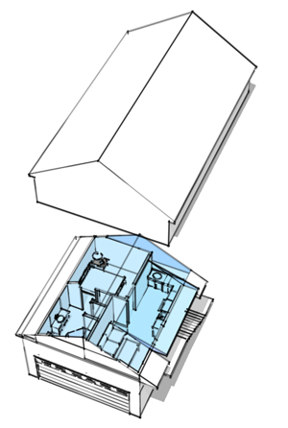
Background
| Known Issues
Digital ease of use - enCodePlusTM
Reorganization / consolidation of tables
Efficiency of overlay/special purpose districts
Clarification of Trust Fund
Best practices for incentivizing:
Appropriate increased density
Affordable / work force housing
Low-impact development
Notes:
Brian

Slide 9
Background
| Known Issues
Ideally, a UDC should:
Assure the protection of the public's health, safety, and welfare
Implement the land use policies Plan CC, the Area Development Plans, and City master plans
Be flexible enough to allow property owners the freedom to create lasting, valued, and affordable communities without unreasonable regulatory barriers that may delay a project or stifle creativity
Notes:
Brian

Slide 10
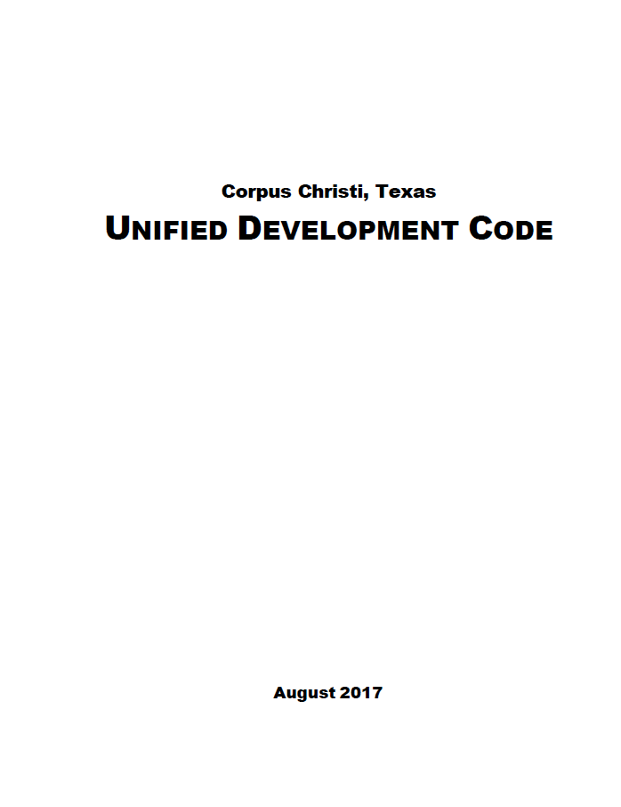
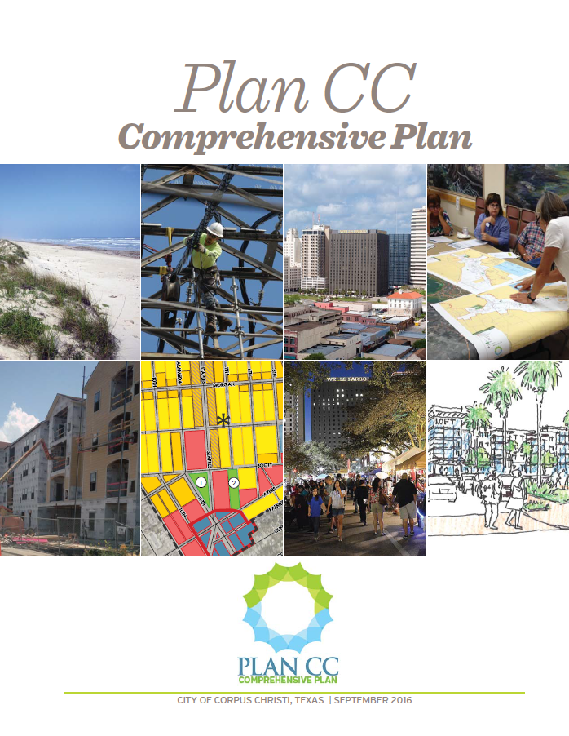
Background
| Plan CC and UDC
Current UDC adopted in 2011
Zoning Ordinance
Platting Ordinance
Other development regulations
Plan CC adopted in 2016
Environment
Housing
Economic Development
Transportation
Infrastructure
Land Use and Urban Design
Implementation
UDC amended almost 40 times since adoption
Notes:
Brian

Slide 11
Background
| Public Engagement
Stakeholder Interviews
City Staff
Appointed Officials
Engineers, Contractors, and Designers
Builders
Environmental Organizations
Architects and Planners
U.S. Navy Air Station Representatives
Downtown Advocates
Realtors and Property Owners Association Representatives
Open Door Meetings
Presentations to PC and CC - Upcoming
Topics of Discussion
Administration & Interpretation
Affordable Housing
Building and Site Design / Urban Design
Conflicts in UDC
Development Review Procedures
Growth
Infill and Redevelopment
Parks, Open Space, and Environment
Platting, Public Improvements, Utilities
Transportation
Trust Fund
Zoning and Land Uses
Notes:
Brian

Slide 12
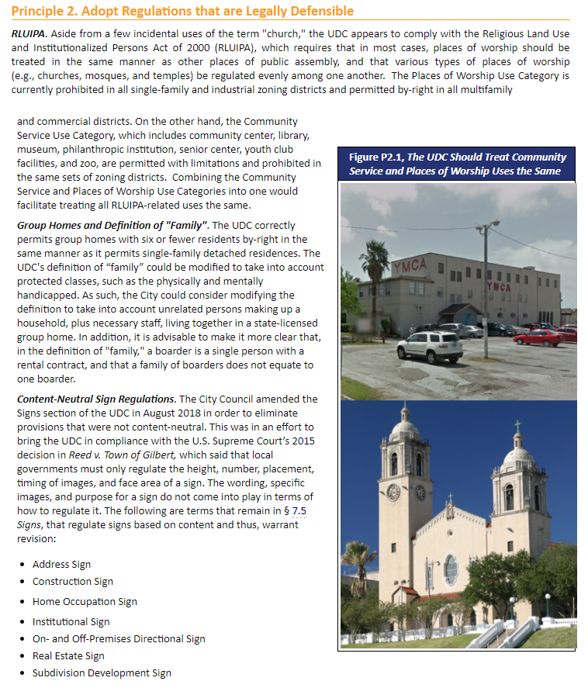
Evaluation
| Structure
Executive Summary
Section 1. Planning, Zoning, and Platting Basics
Section 2. Plan Conformance
Section 3. UDC Best Practices
Section 4. Zoning Districts and Land Uses
Section 5. Development Standards
Section 6. Development Review and Administrative Improvements
Appendix A. Stakeholder Interview Summary
Appendix B. Key Terms
Notes:
Brian

Slide 13
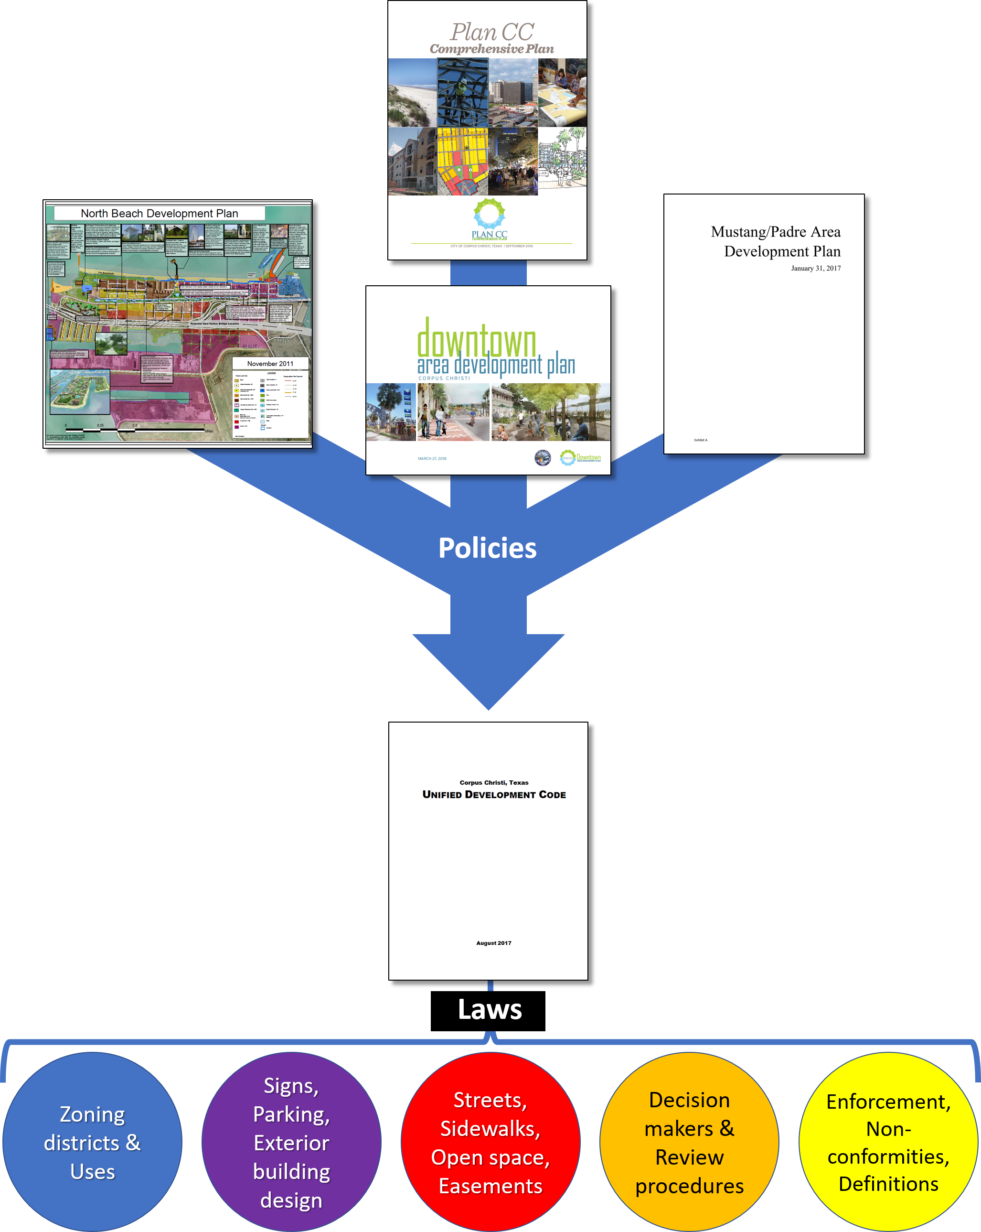
Evaluation
| Planning & Zoning Basics
Plans set broad policies for the growth and economic development of the City and its specific areas
The UDC is a set of laws, procedures, standards, and a map that implement those policies
Zoning divides the City into districts
Each district has:
A uniform set of permitted, limited, special, and prohibited uses
Consistent dimensional standards (height, setbacks, lot size)
Consistent development standards (landscaping, signs, building materials)
Notes:
Brian

Slide 14
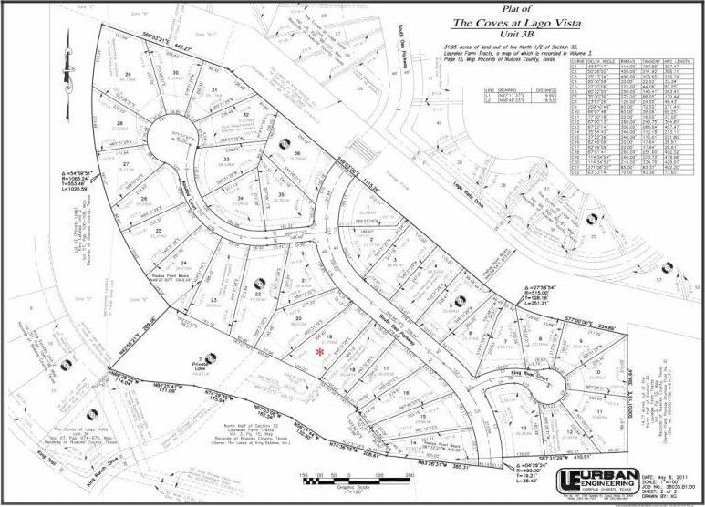
Evaluation
| Platting Basics
Platting relates to the subdivision of land into smaller lots
Lot lay out
Access to adequate infrastructure
Streets
Open Space / Parks
Sidewalks
Easements
Utilities
Procedures from plat submittal to recordation
City participation and trust fund
Notes:
Brian

Slide 15
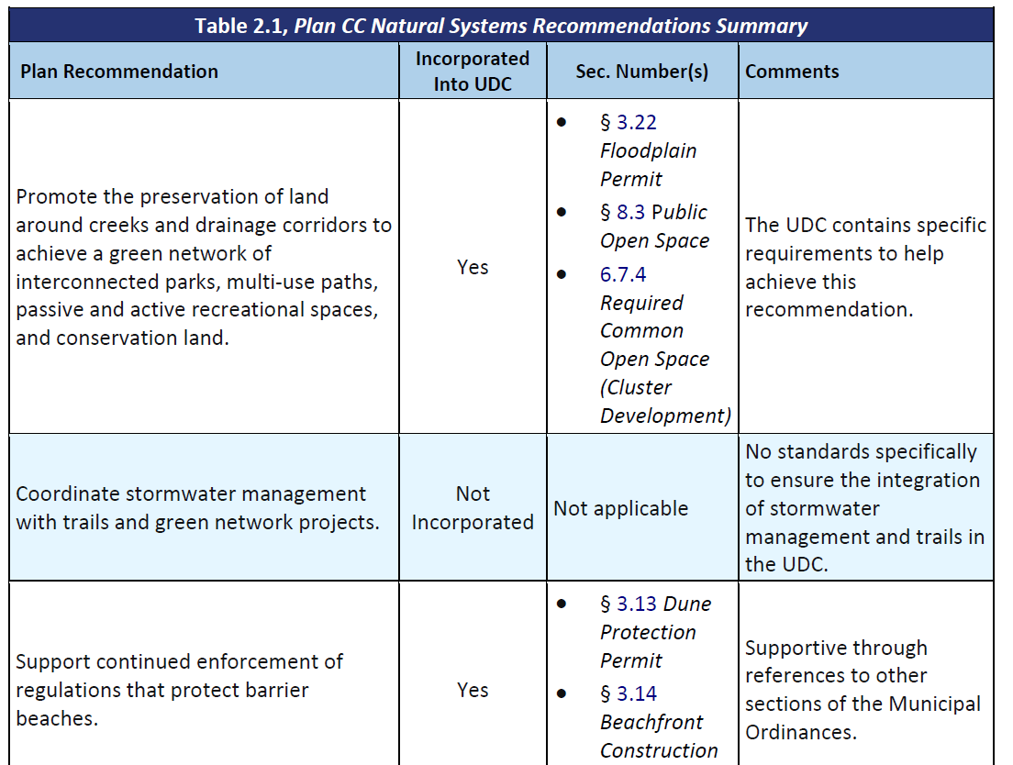
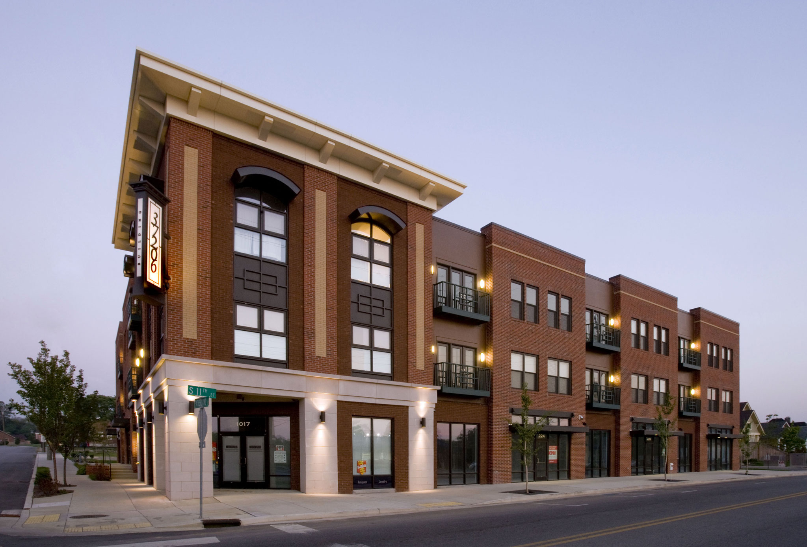
Evaluation
| Plan Conformance
Plan CC
ADPs
North Beach
Downtown
Mustang-Padre Island
Strategic Plan for Active Mobility (Bicycle Plan)
Make mixed-use environmentally-sensitive development easier and more feasible
Allow greater housing choice in order to promote affordability and decrease monotony
Encourage development that makes the City a better place to live, work, study, and play
Notes:
Brian

Slide 16
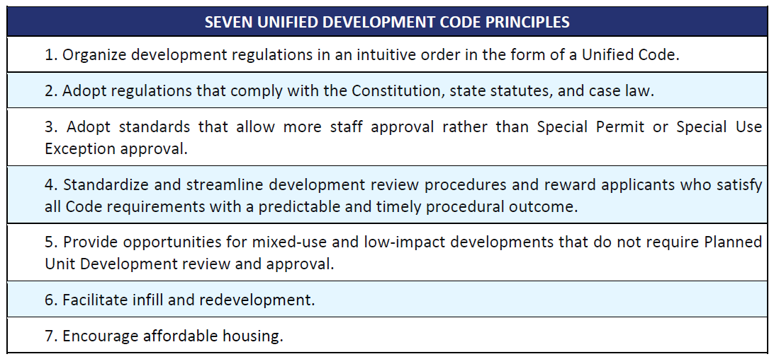
Evaluation
| UDC Best Practices
Sample Recommendations
Reconcile conflicts between UDC and remainder of City Code
Ensure sign regulations are completely content-neutral
Allow some administrative subdivision Waiver approval subject to if certain criteria are met
Bring Written Interpretations into UDC
Incentivize low-impact or mixed-use developments by providing density or intensity bonuses (where appropriate), reduced parking, or increased height limits
Create Neighborhood Conservation district(s) that reduce the need for Variances and facilitates investment in properties
Allow increased density, housing types that would not typically be permitted, and / or reduced permitting fees for infill scenarios
✓
✓
✓
✓
Notes:
Brian

Slide 17
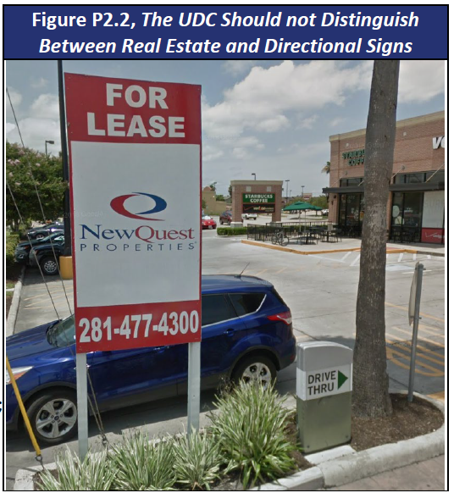
Evaluation
| Content-Neutrality
Reed v. Town of Gilbert Supreme Court Case
Signs cannot be regulated based on their content or purpose
Recent amendment to UDC removed several non- content-neutral provisions
Some sign types remain that are not content-neutral
Address Sign
Construction Sign
Home Occupation Sign
Institutional Sign
On- and Off-Premises Directional Sign
Real Estate Sign
Subdivision Development Sign
Notes:
Brian

Slide 18
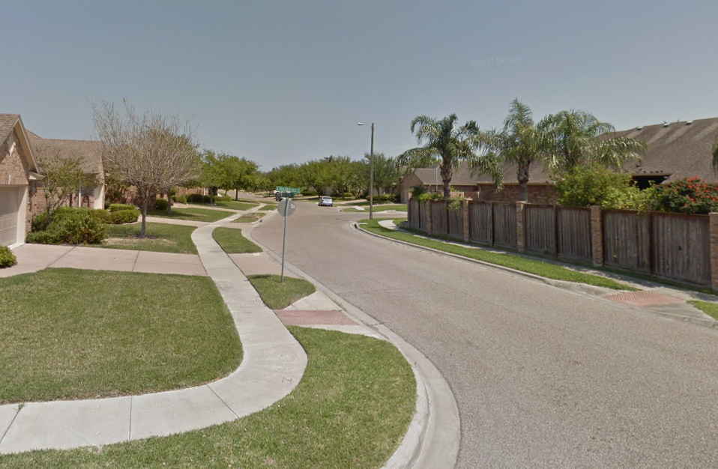
Evaluation
| Subdivision Waivers
Multiple concerns from Stakeholders
Make the Waiver section more visible
Planning Commission currently takes action
Make some Waivers administrative subject to criteria
Potential Administrative Review Criteria for Sidewalks
All lots are greater than one acre in area (sidewalks are already not required in the F-R, Farm-Rural, and RE, Residential Estate zoning districts).
A minimum of 50 percent of the improved lots within 500 feet and on the same side of the street are without sidewalks.
The Waiver does not prevent the City from installing sidewalks at some later date.
Pedestrian traffic will be accommodated in some other manner.
The subdivider will pay a fee-in-lieu of construction of sidewalks that goes toward sidewalk projects for the City.
Notes:
Brian

Slide 19
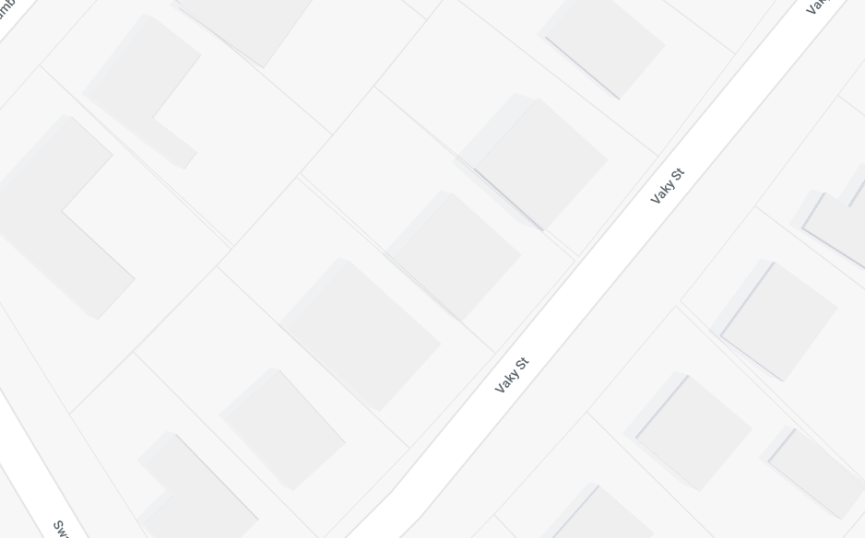
Evaluation
| Neighborhood Conservation
Special zoning district to mimic what is already on the ground
Targeted for residential areas not expected to transition to commercial
Granted as conforming rather than nonconforming
Frequent concern when updating a UDC
Allow for modest additions without the need for Variances subject to criteria
Easier to insure and finance
Faster approval
NC district would enable expansions of a nonconforming structure without a Variance
Notes:
Brian

Slide 20
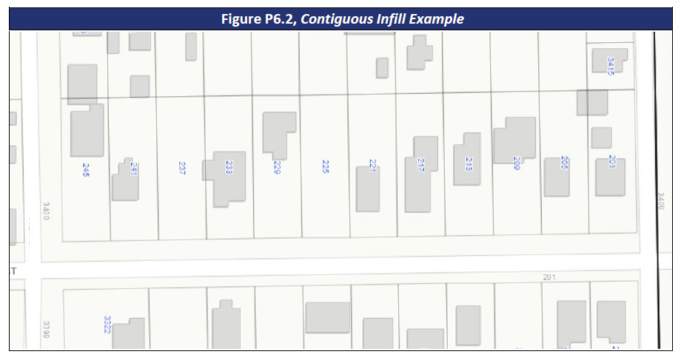
Evaluation
| Infill & Redevelopment
Adopt provisions that reward infill / redevelopment of contiguous lots (200 linear feet for example)
UDC could allow increased density (narrower lots) and additional housing types where developer purchases, replats, and redevelops an expanse of contiguous lots
Example
600-foot block with 50-foot wide lots that is zoned Single-Family, RS-6
Near neighborhood necessities, such as a school, corner store, and park; has adequate streets
More lots for developer to sell than otherwise would have existed
Public gains increased numbers of affordable housing units.
Narrower lots → Increased lot count and more housing types → More attractive to redevelop / infill
Notes:
Brian

Slide 21
Evaluation
| Detailed Comments
Sample Comments from Articles 1 through 3 and 9 and 10
1.5.1. Public Provisions - Address the internal conflicts between text, graphics, and tables throughout the UDC.
1.5.2. Private Provisions - Note that the UDC is not intended to nullify or repeal any public or private laws, easements, or deed restrictions.
1.11.3 Defined Terms - Examine the defined terms and add or remove definitions as needed.
3.7.2.A.2 Technical Review Committee Review - Relocate the requirement of TRC members commenting on applications to § 2.7. Technical Review Committee, so it applies to any application reviewed by the TRC.
3.8.3.E. Expiration (Preliminary Plat) - Place a limit on the number of extensions that may be approved for a single preliminary plat before the plat requires resubmission.
Notes:
Brian

Slide 22
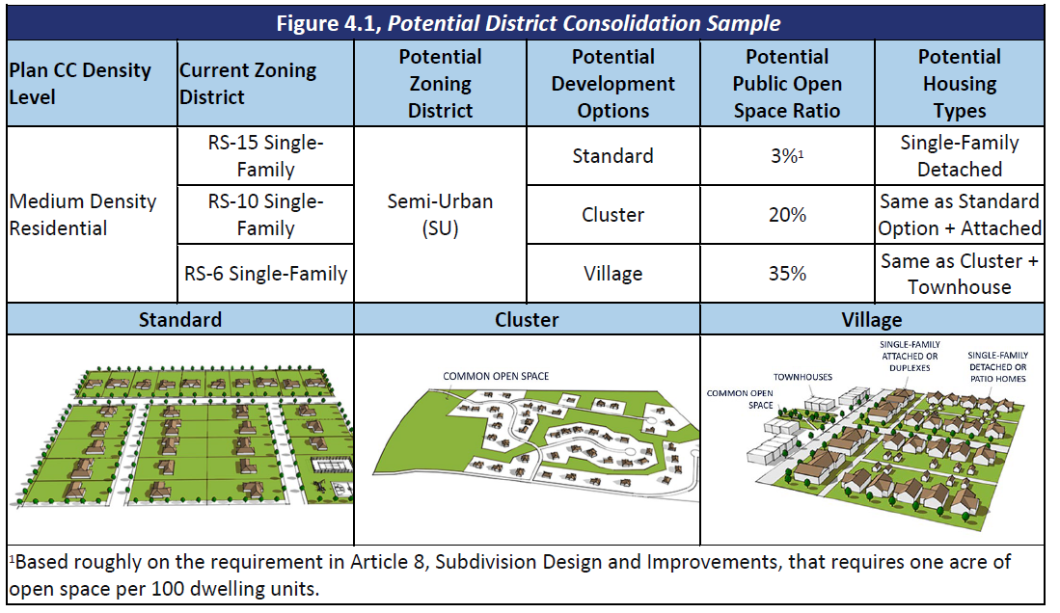
Evaluation
| Detailed Comments
Sample Comments from Articles 4 through 6
Table 4.1.1 Zoning Districts - Seek opportunities for zoning district simplification / consolidation based on development options within the broader zoning district.
Notes:
Brian

Slide 23
Evaluation
| Detailed Comments
Sample Comments from Articles 4 through 6
§ 5.1 Use Categories - Add new land uses as technology and trends evolve such as tiny homes, scooter-charging home occupations, or solar panels.
Table 4.4.4 Multi-Family Housing Types - Integrate a new housing type known as a multiplex, which has three units, but is typically not part of an apartment complex.
Notes:
Brian

Slide 24
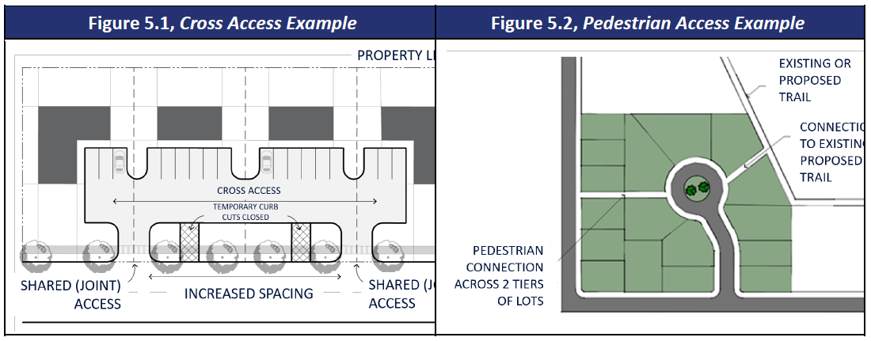
Evaluation
| Detailed Comments
Sample Comments from Articles 7 through 8
7.1.8. Shared and Cross Access Driveways - Require, rather than allow or encourage, cross access driveways for multi-family, nonresidential, and mixed-use developments
Table 7.2.2.B Parking Ratios – Adjust parking ratios to reduce development costs, the heat island effect, and impervious surface. Examples include:
1 bedroom apartments - reduce from 1-1/2 spaces per unit to 1space per unit.
2 or more bedroom apartments - reduce from 2 spaces per unit to 1-1/2 per unit.
8.2.3.C Access Easements and Other Easements - Provide for pedestrian access easements at the end of cul-de-sac bulbs, particularly where cul-de-sac abuts a trail or is within two tiers of lots from a sidewalk
Notes:
Brian

Slide 25
Next Steps
| Schedule
Revisions to Evaluation based on Staff and public comments
Final Evaluation – Provide to Staff on week of April 8
Presentation to Planning Commission – Wednesday, April 17
Presentation to City Council – Tuesday, May 14
Work Program, Schedule and Cost Estimate for future work – Provide to Staff week of May 20
PDF and interactive version of Draft Evaluation – https://www.cctexas.com/UDC
Email DSOutreach@cctexas.com
Notes:
Brian

Slide 26
Thank You!
Comments / Q&A

