Slide 1
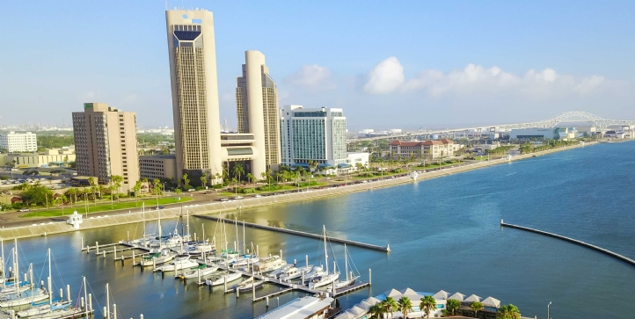
Potential Costs of Ozone Nonattainment in the Corpus Christi Metropolitan Area
August 25, 2020

Slide 2
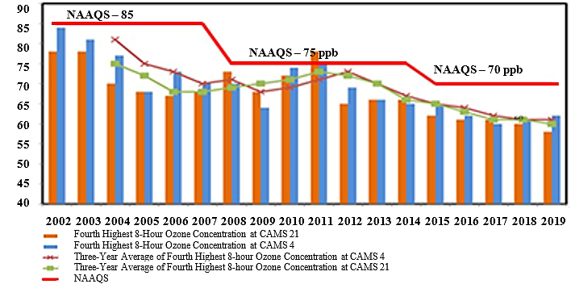
Corpus Christi Area Ozone Concentration, ppb.
Notes:
Good morning, commissioners. Before I begin, please keep in mind that the area is currently not in danger of losing the ozone attainment status.
In fact, the ozone level has been trending down in the past 10 years, thanks in part to the Port along with Gretchen’s Coastal Bend Air Quality Partnership.
So, instead of cost estimates, you may also interpret all the estimates I am about to present as the benefits of achieving ozone attainment.

Slide 3
Potential Cost Types
General Conformity
local industry expansion & emission control costs
construction project delays
Transportation Conformity
road construction delays
vehicle inspection costs
Educational/Outreach Programs
Voluntary Control Programs

Slide 4
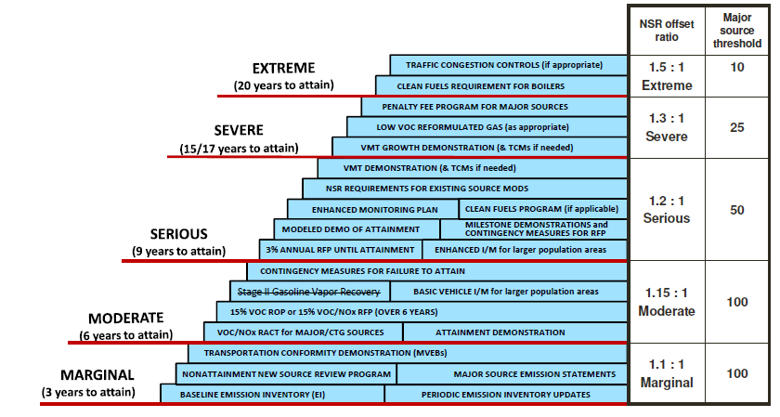
Overview of Clean Air Act Ozone Planning and Control Requirements by Classification

Slide 5
Total Annual Projected Potential Costs
 | Marginal Nonattainment (>70 ppb) |  | Moderate Nonattainment (>80 ppb)
 | Low Estimate | High Estimate | Low Estimate | High Estimate
Impact on Local Industry | $565,945,755 | $1,690,216,126 | $566,376,968 | $1,697,857,641
Losses due to Road Construction Delays | $20,263,963 | $20,291,740 | $27,348,016 | $27,373,016
Vehicle Inspection Costs | – | – | $5,769,684 | $9,281,666
Educational/Outreach Program Costs | $123,474 | $123,474 | $261,148 | $261,148
Costs of Voluntary Control Measures | $29,655 | $29,655 | $29,655 | $29,655
Corpus Christi MSA | $586,362,847 | $1,710,660,996 | $599,785,472 | $1,734,803,126
Notes:
As a hypothetical/counterfactual exercise, Corpus Christi will receive a marginal nonattainment designation if the ozone level is higher than 70 ppb; and moderate nonattainment for 80 ppb.
The estimates of the total costs range between $586 million and $1.7 billion each year.
The low estimates are conservative, realistic estimates based on the costs of existing nonattainment areas. The high estimates are so-called worst case scenarios that are less likely to happen.
The broad categories of costs are impact on industry, costs related to road construction delays, vehicle inspection, and educational programs are required under nonattainment.
As you can see, the impact on local industry makes up about 95% of the total cost estimates.

Slide 6
Annual Projected Costs on Industry
 | Marginal Nonattainment (>70 ppb) |  | Moderate Nonattainment (>70 ppb)
 | Low Estimate | High Estimate | Low Estimate | High Estimate
Cost of NNSR Permitting | $186,222 | $465,556 | $186,299 | $465,748
Cost of Industrial Project Delays | $10,111,927 | $10,111,927 | $10,111,927 | $10,111,927
Lost Firm Expansion/Relocation | $554,785,332 | $1,664,355,997 | $554,785,332 | $1,664,355,997
Costs of Point Source Reduction | $862,273 | $15,282,646 | $1,293,409 | $22,923,969
Total | $565,945,755 | $1,690,216,126 | $566,376,968 | $1,697,857,641
Notes:
Next, we dive into the specifics in the impacts on local industry.
First, there are explicit costs, such as a special permitting process called Nonattainment New Source Review and the costs to reduce or offset any Point Source emissions.
The second type of costs are implicit costs, such as construction delays up to 1 year associated with a longer permitting process and potential losses from losing the opportunity for some firms to expand or relocate to Corpus Christi.
Given more than $50 billion in capital investments in the past 10 years, the estimates of lost industry expansion are between $0.5 billion to $1.6 billion a year.

Slide 7
Losses from Firm Expansion/Relocation
Industry | Low Estimate | High Estimate
Oil and Gas Extraction | $11,838,517 | $35,515,551
Petrochemical | $541,959,833 | $1,625,879,500
- Petroleum Refining | $322,734,410 | $968,203,231.71
- Chemical Manufacturing | $142,928,872 | $428,786,616.41
- Plastics Manufacturing | $76,296,551 | $228,889,652.89
Steel & Pipe Manufacturing | $986,982 | $2,960,946
Total | $554,785,332 | $1,664,355,997
Low estimates are based on losing a 1/3 capacity expansion of an average-size firm.
High estimates are based on losing one average-size firm’s relocation to the area.
Notes:
The low estimates are based on the assumption of losing a one-third capacity expansion of an average-size firm in a particular industry.
The high estimates are based on losing the relocation of one average-size firm to the area.
Again, given our recent history, the bulk of the costs would fall on the petrochemical industry and other heavy manufacturing industries.

Slide 8
Comparison of Projected Costs & Time
 | Marginal Nonattainment (>70 ppb) |  | Moderate Nonattainment (>80 ppb)
 | Low Estimate | High Estimate | Low Estimate | High Estimate
Corpus Christi MSA | $586,362,847 | $1,710,660,996 | $599,785,472 | $1,734,803,126
San Antonio | $117,299,799 | $1,019,057,416 | $237,585,294 | $1,207,752,419
Austin | $809,984,168 | $1,384,904,884
Affected Period: 23+ years
3+ years for attainment
2 10-year maintenance periods
Notes:
You’ve seen a lot of large numbers.
One way to bring those numbers to perspective is to compare our estimates with estimates for other areas in Texas.
Our estimates for Corpus Christi are higher than San Antonio’s, even though their economy is 4 times larger.
Again, Corpus Christi is smaller than Austin, but our total cost estimates are very close to Austin’s.
Our relatively high cost estimates are mostly related to the strong growth in industrial construction in the past 10 years.
It is also important to keep in mind that all estimates are on an annual basis.
The window of nonattainment is at least 23 years: It takes 3+ years for the attainment designation. And then there are two 10-year maintenance periods.
In other words, it will take a whole generation to bear the costs of ozone nonattainment.

Slide 9
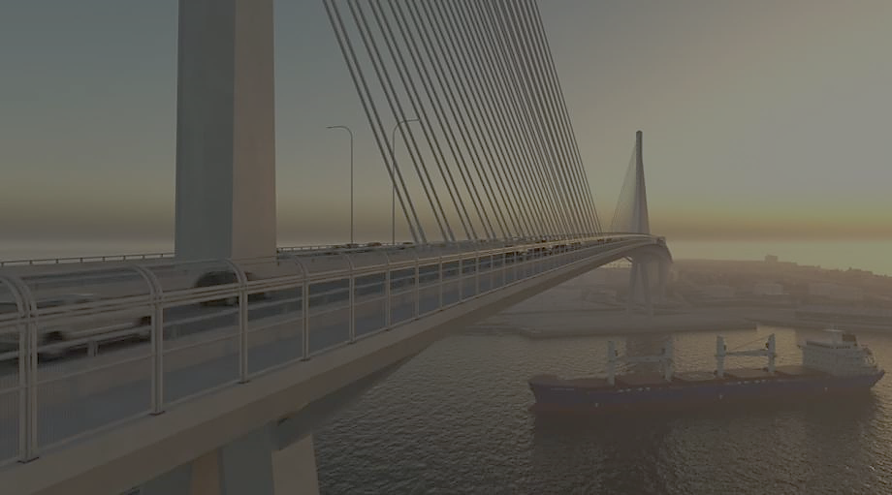
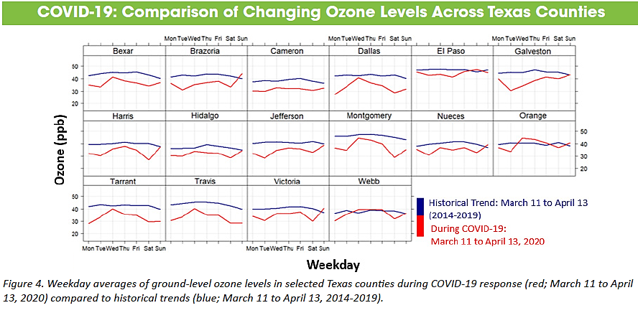
A 25% reduction in vehicle travel in Corpus Christi resulted in a 12.5% reduction in the ozone concentration. The economic cost is obvious!
Notes:
Our potential cost estimates are within 5% of the metro area GDP at $23.5 billion.
By comparison, a comparable reduction in the ozone level by about 10% during the COVID-19 lockdown period in March-April resulted in a 33% reduction in GDP (nationwide). The cost of clean air is now obvious.

